Slide 1
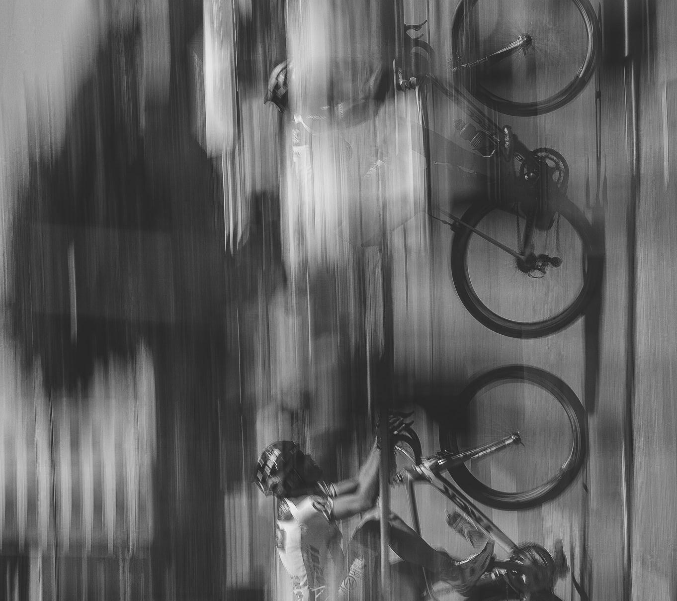
A1: Team 4
Bike Light
Anvitha Nekkanti, Sebastian Gilligan,
Arya Padalkar, Ethan Rapa

Slide 2
Problem Statement
The goal is to design a smart bike light that provides illumination in a variety of circumstances to warn others of the bike rider’s presence and help the bike rider react to obstacles.

Slide 3



Objectives & Metrics
Illuminating
Sensing
Compact
Long Lasting
200-600 Lumens ANSI/NEMA FL-1 Standard
Can detect ambient light and motion
Smaller than 6” across
Can last 3 hours, 20 minutes at max brightness. 10Ah battery, 3A max load.
Notes:
Constraints: materials available (certain vendors), cost (must be within the budget), amount of time (must have finished product by product showcase)

Slide 4
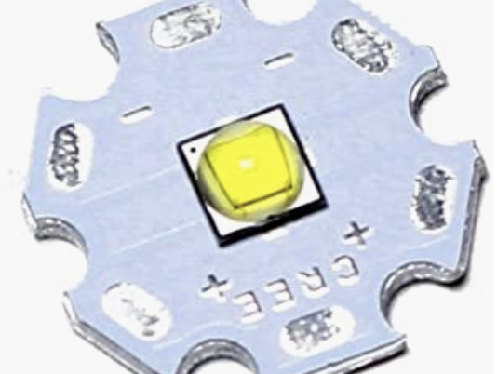
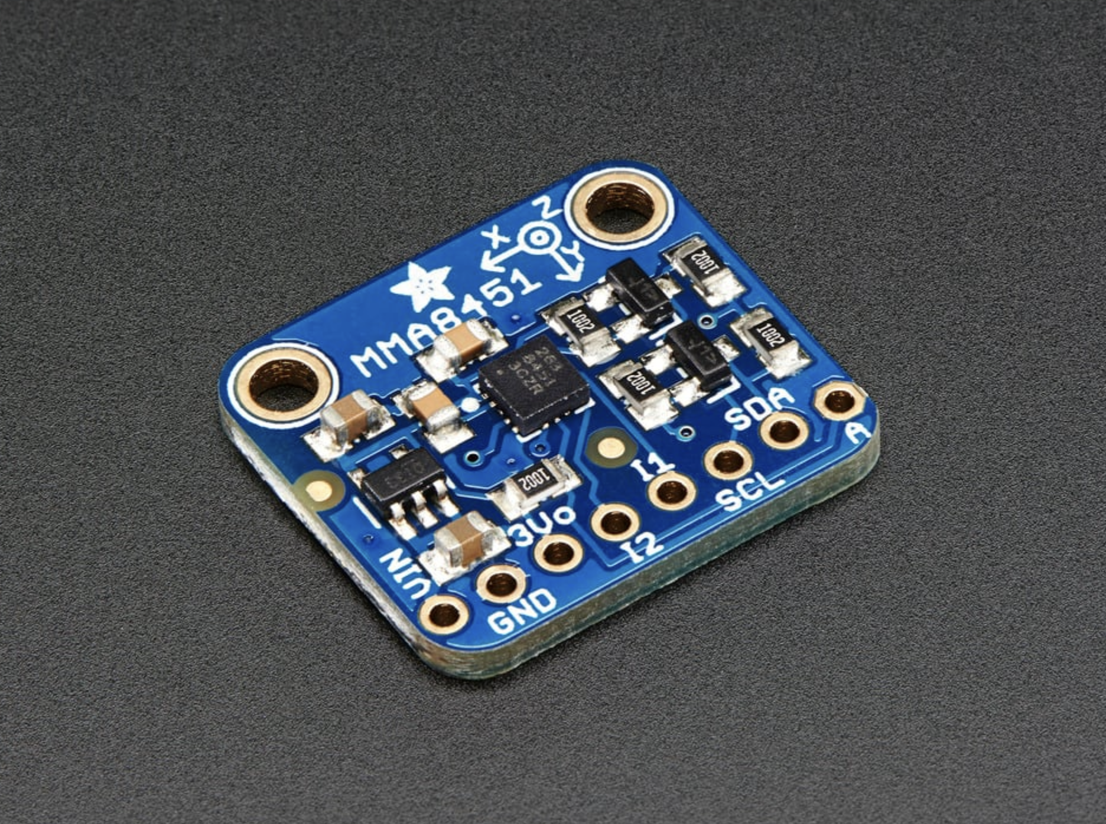
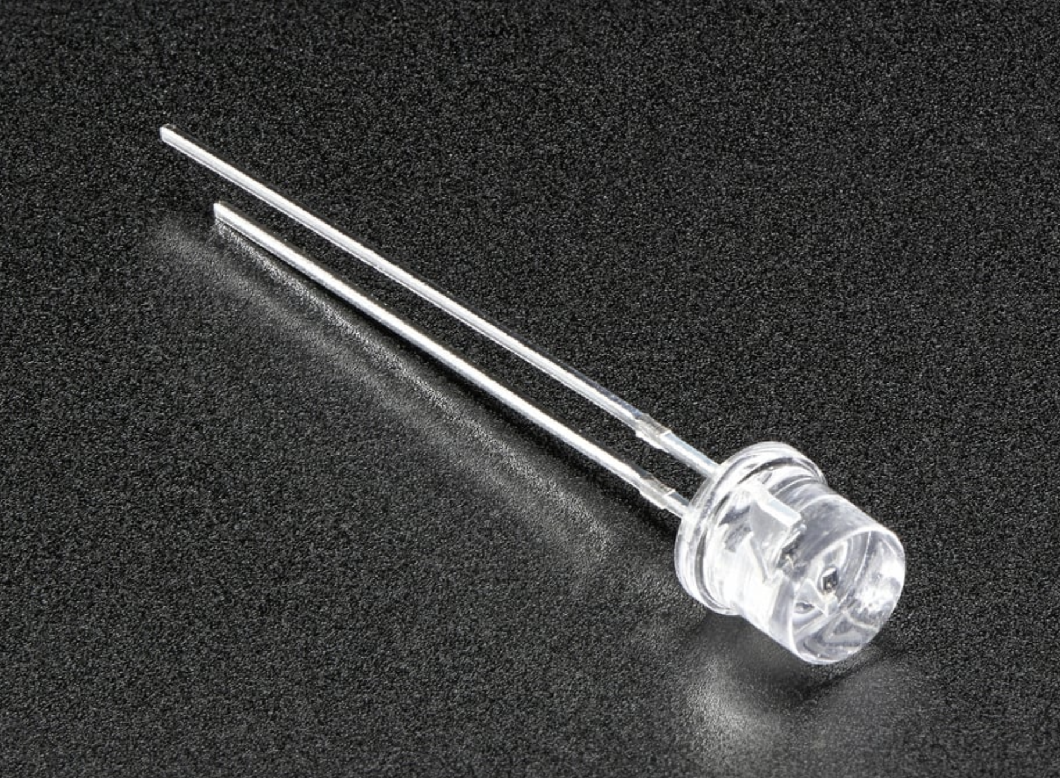
Key Parts
LED
Accelerometer
Phototransistor
White LED, 10 W, 3.7 A
Triple Axis Accelerometer,
+/- 2/4/8 g
Simple sensor that detects ambient light

Slide 5
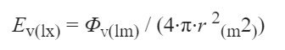
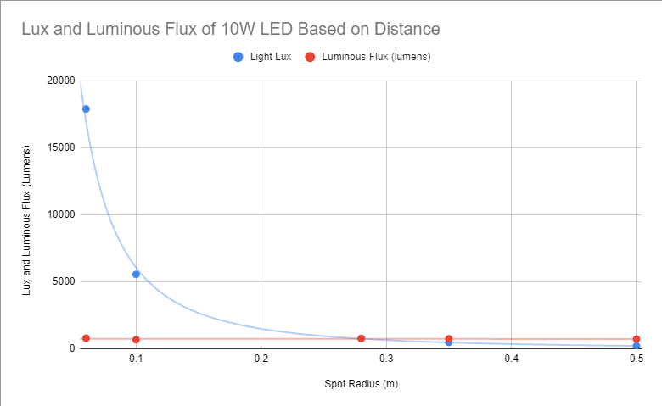
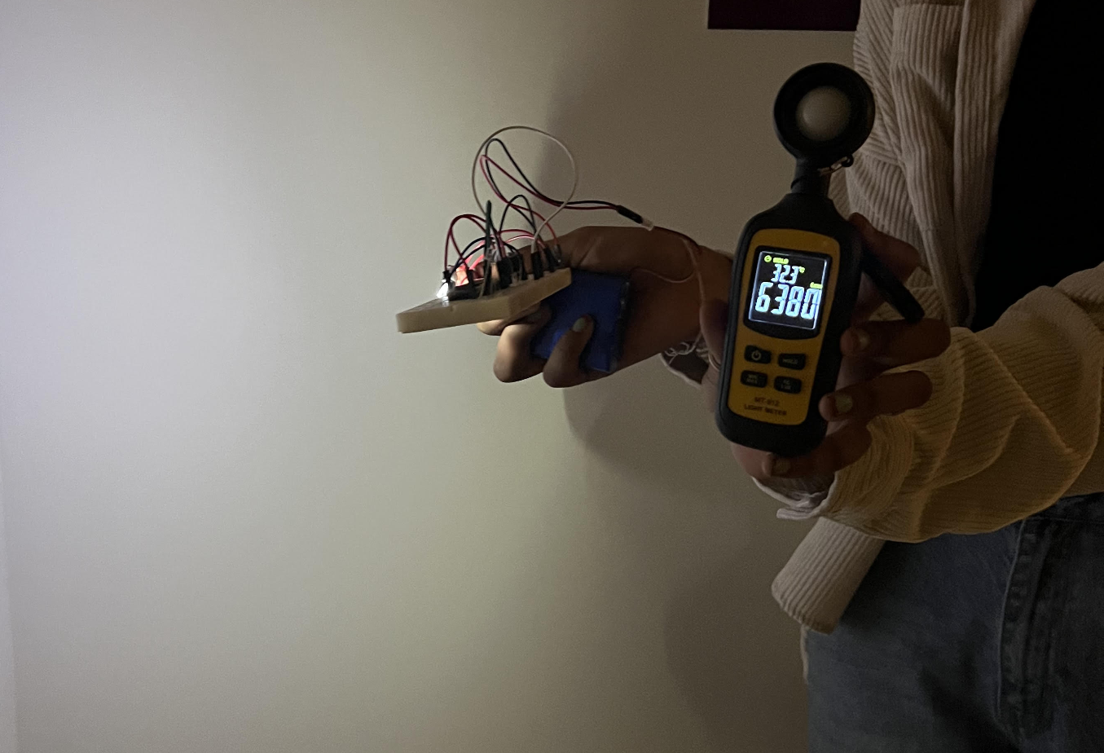
Light Testing
Through preliminary research :
Average Lumen value was 791 lumens
Direct preliminary research procedure
Tells us we need more light!
Hope to adjust this value for the future
Study offered quantitative insight into the effectiveness of our light
Systematic error present
Can compensate with more LEDS

Slide 6
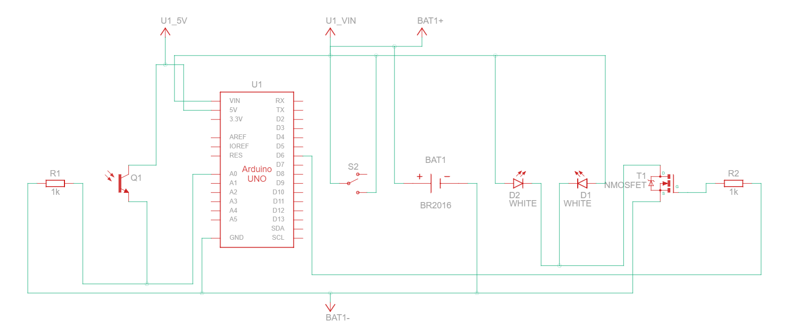
Circuit Diagram
Master Switch
MOSFET
Phototransistor
Arduino Nano w/ Accelerometer
Battery
LEDs

Slide 7

Prototype Demonstration

Slide 8
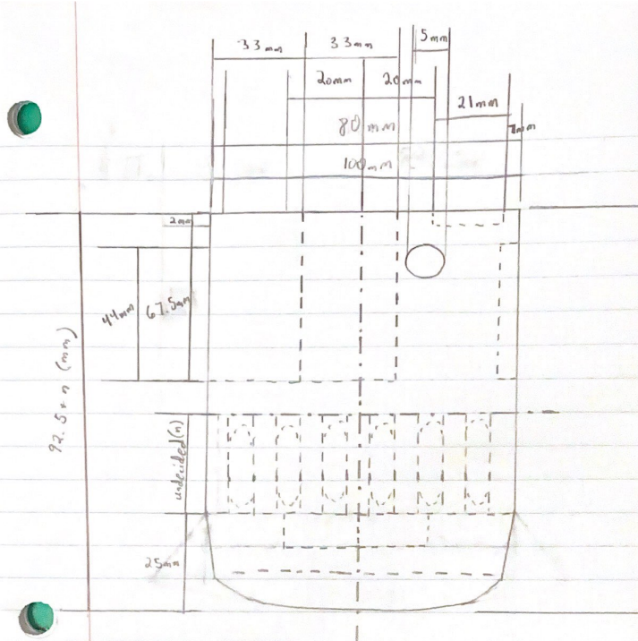
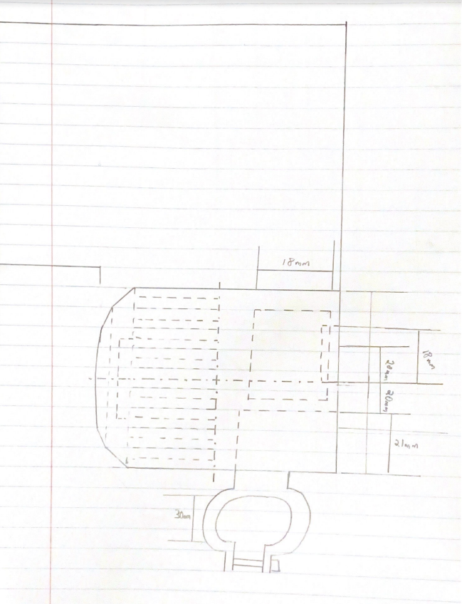
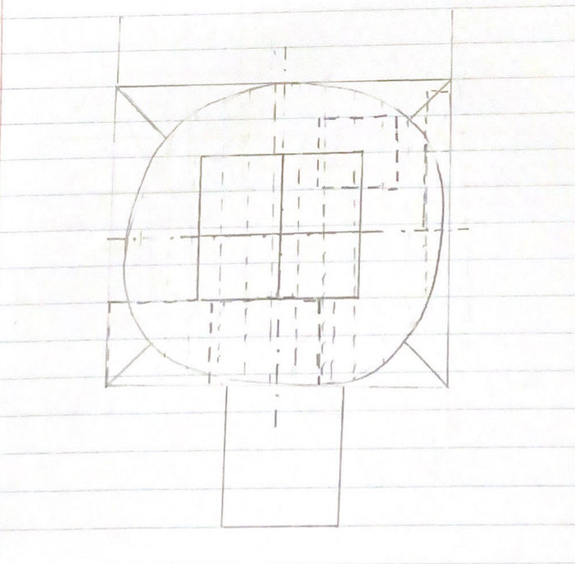
Housing Sketches

Slide 9
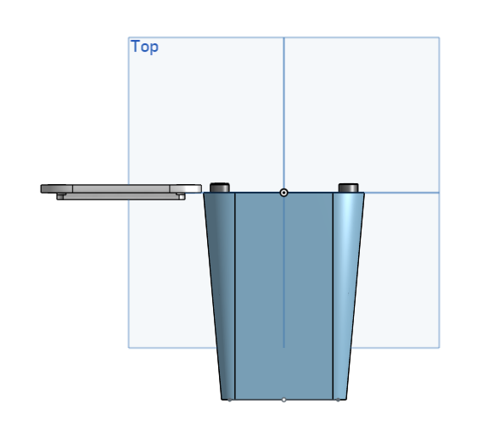
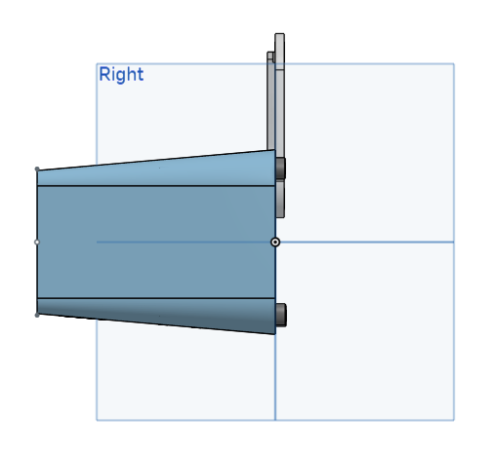
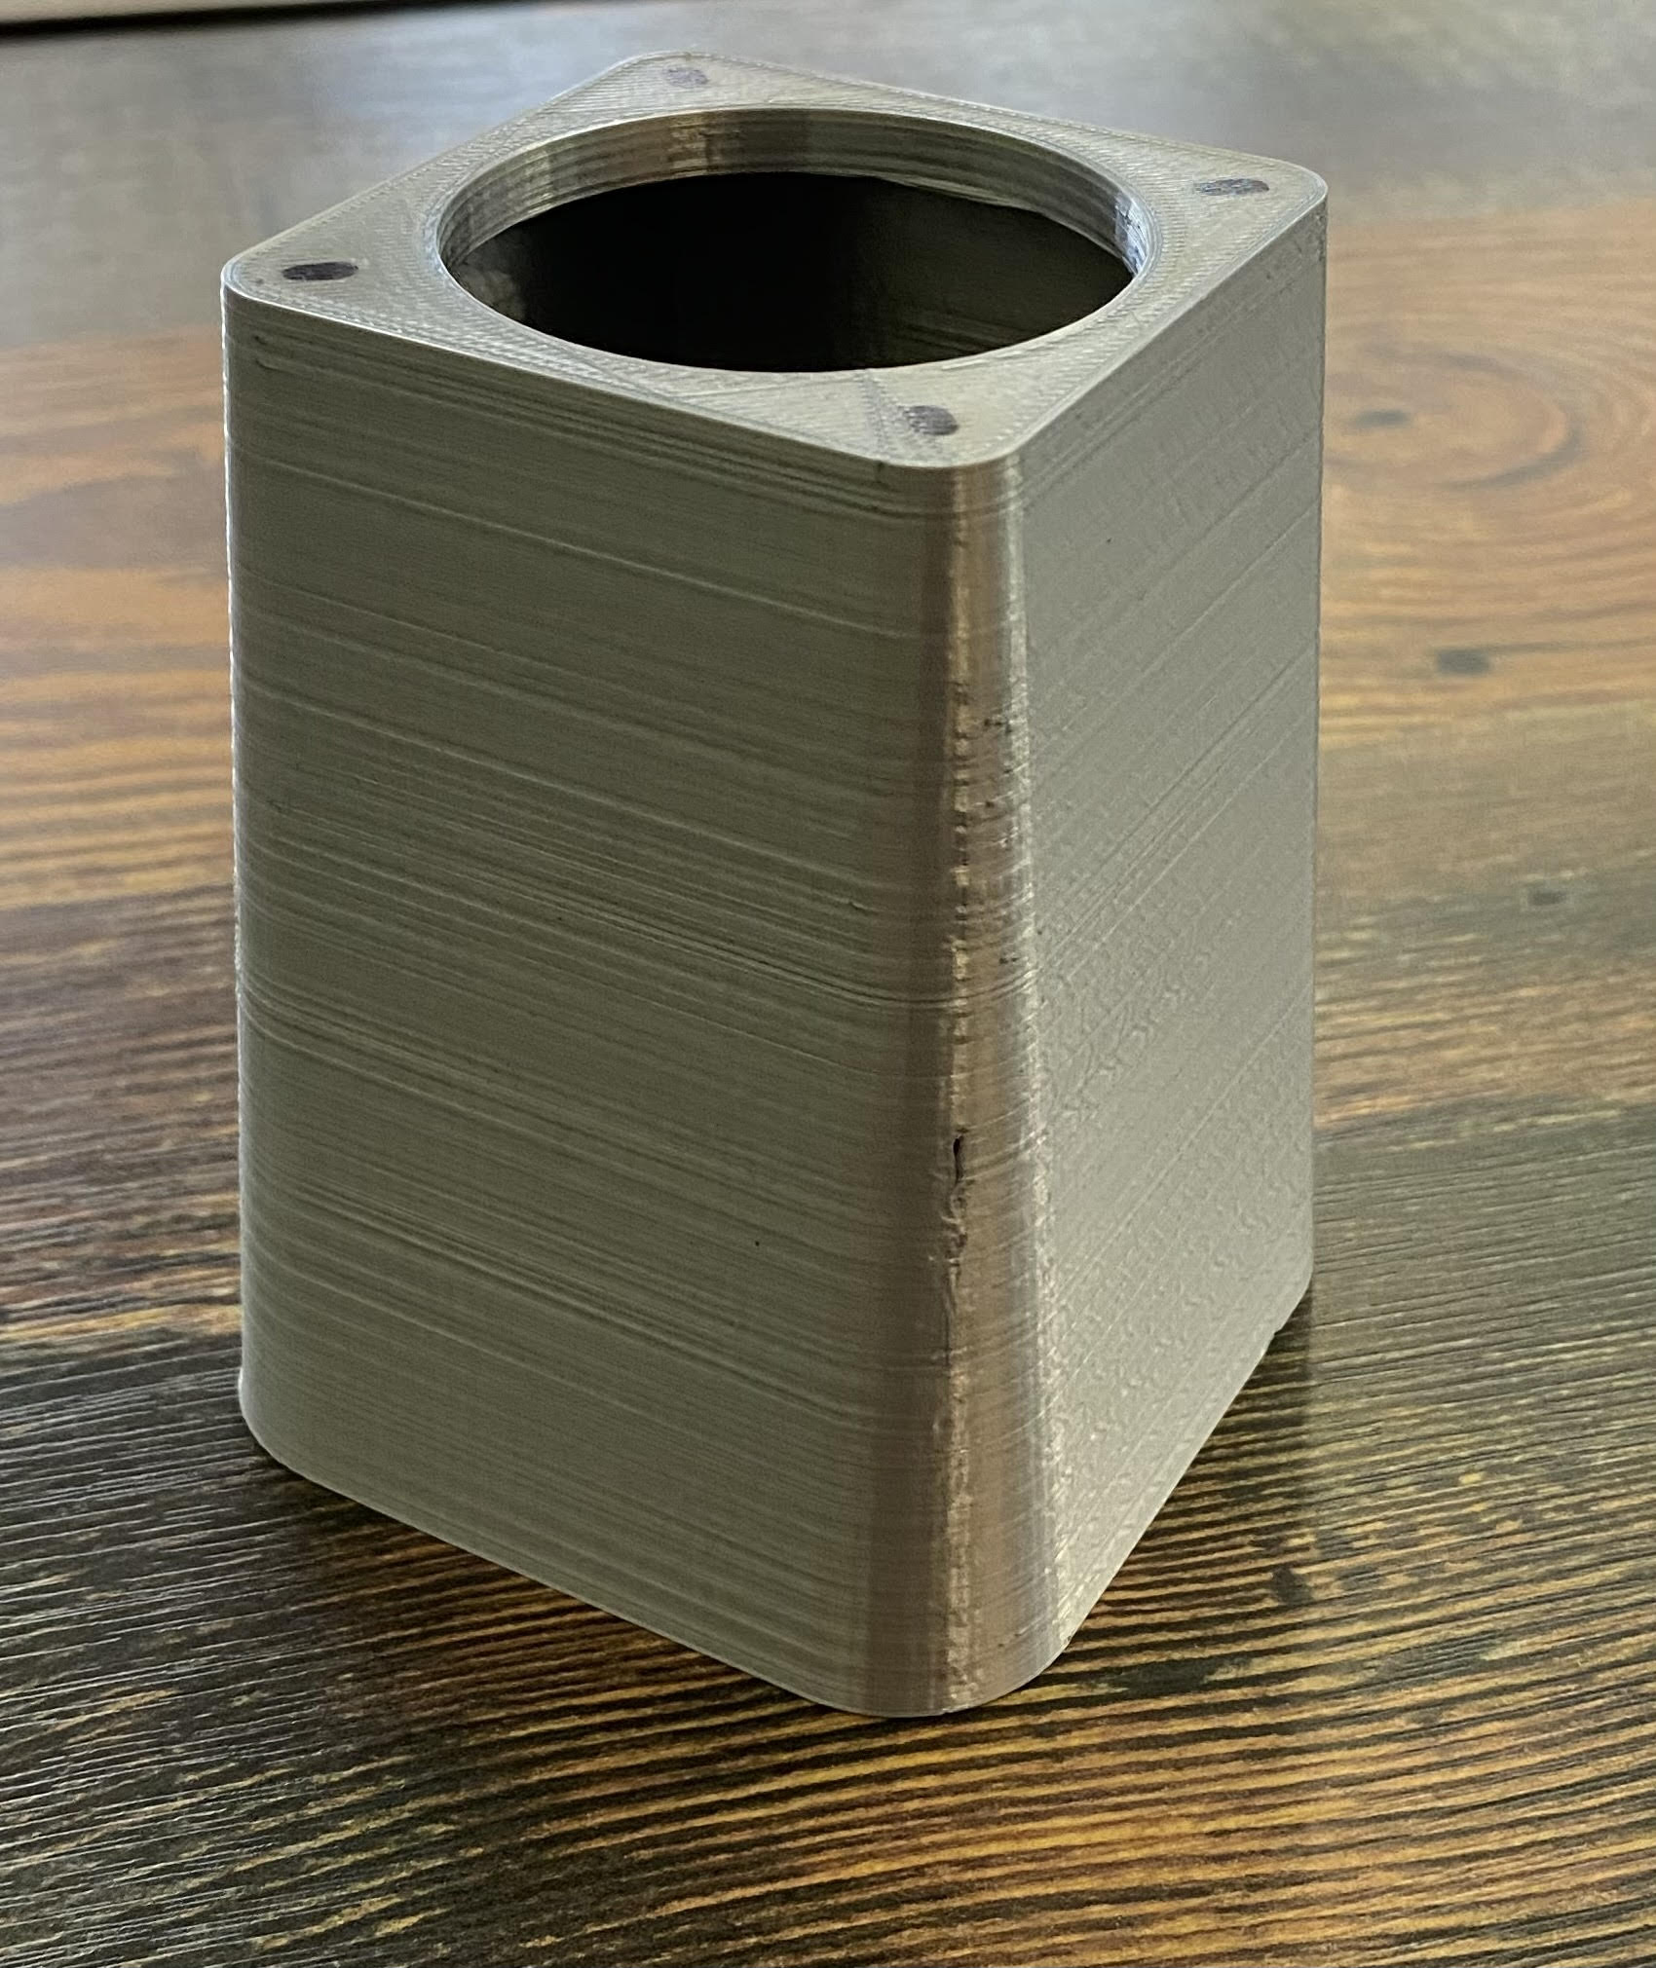
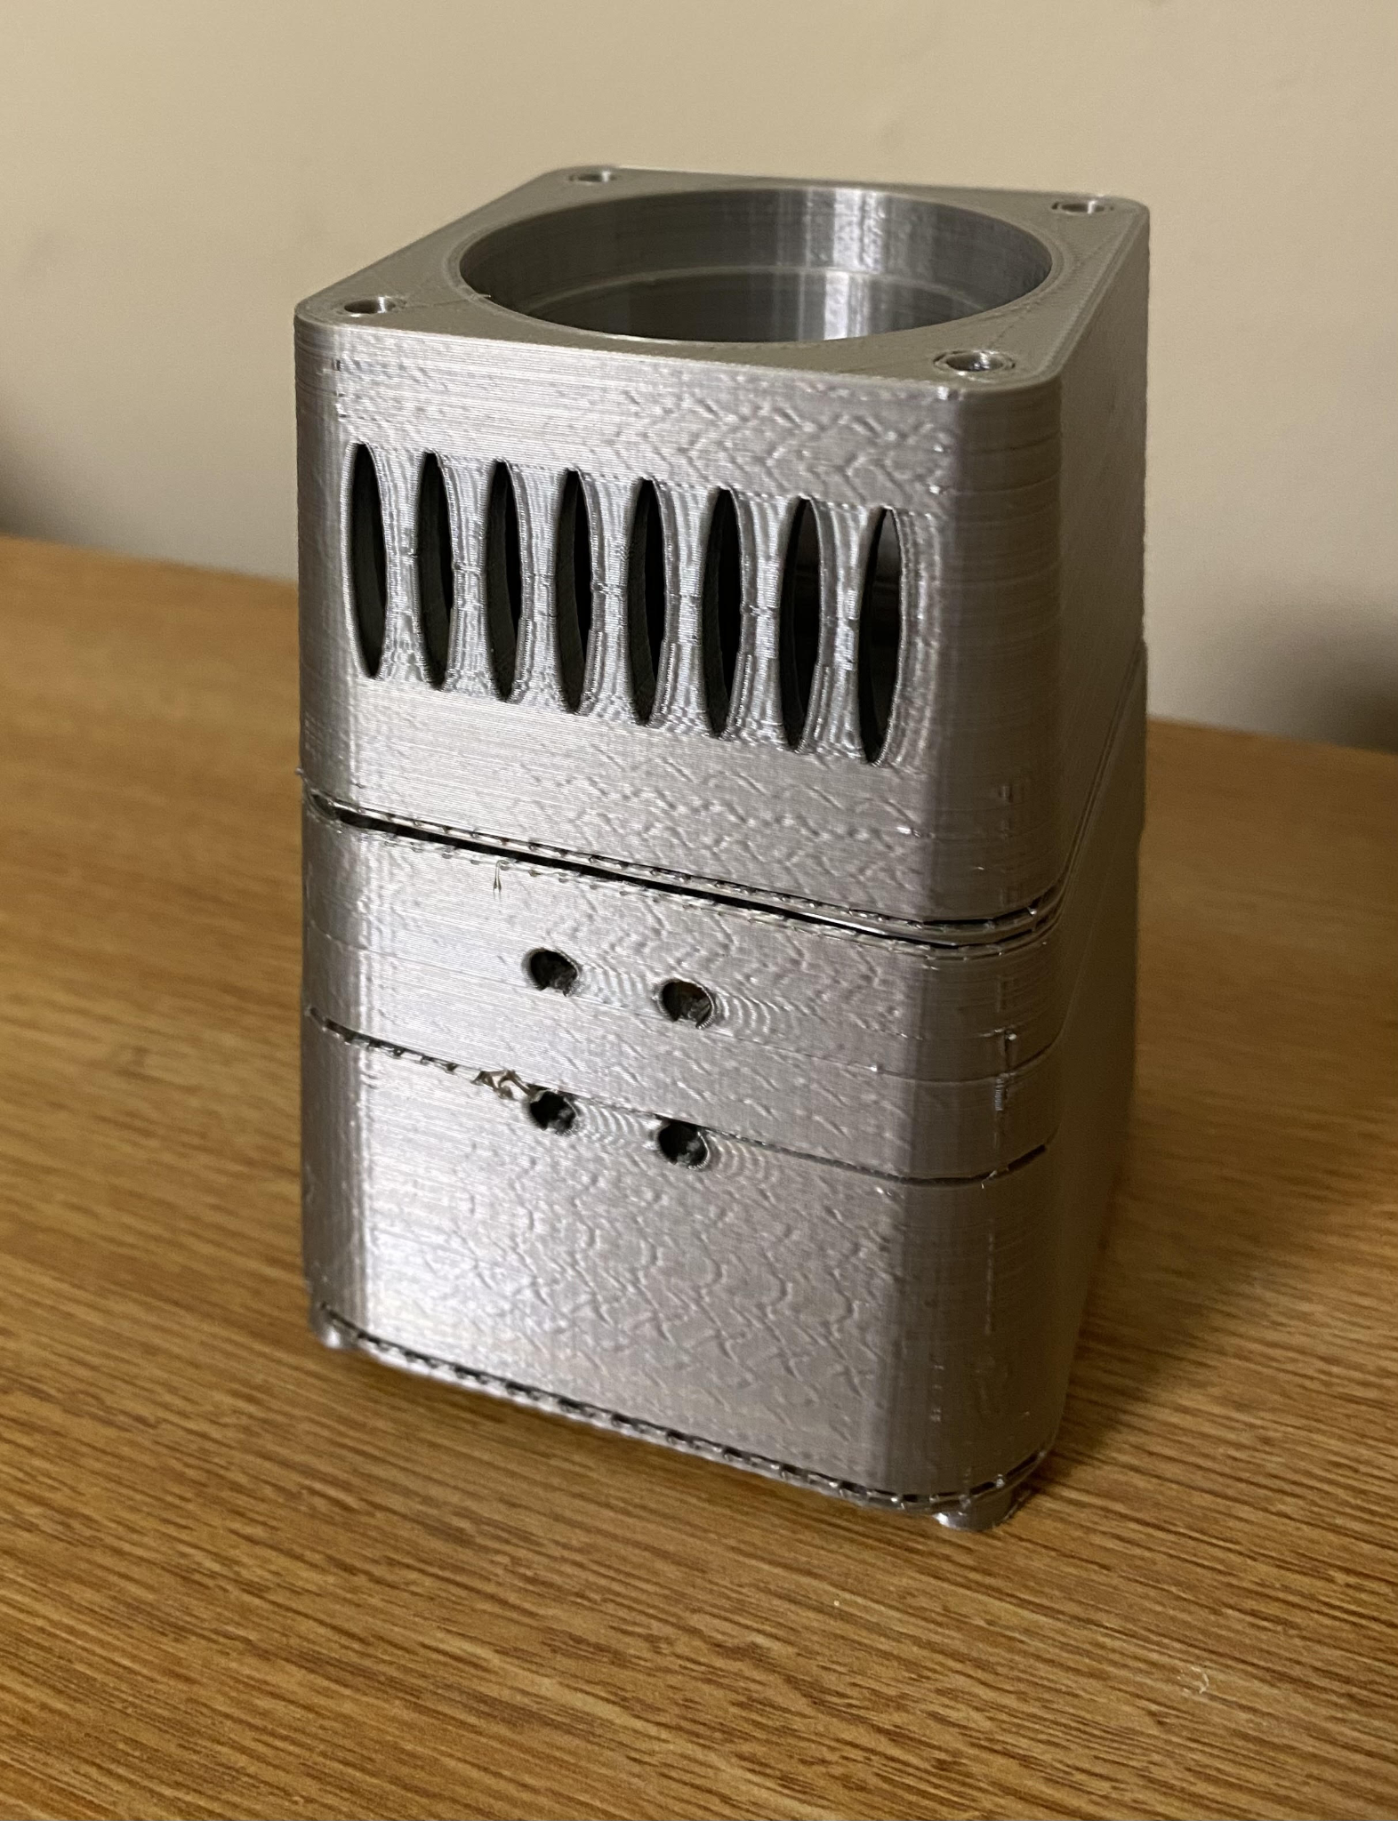
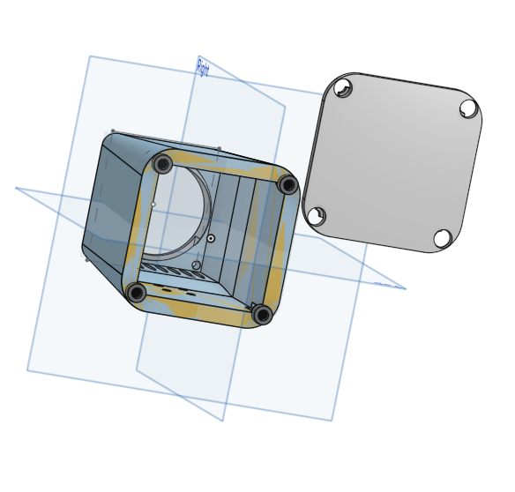
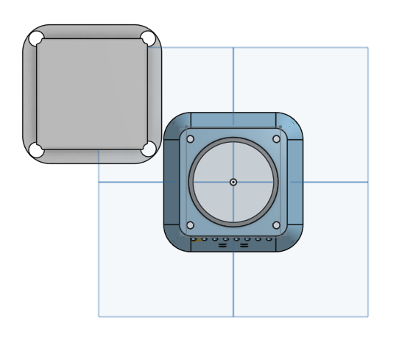
Housing Design
Top
Right
Bottom
First Iteration
Second Iteration

Slide 10



Next Design Iteration
Battery
LED
Clamp
Button
Look into battery charging methods
Find ways to make light brighter - lens, LEDs
Attach adjustable clamp to enclosure; determine static equilibrium of system
Incorporate a master on and off switch into design

Slide 11

Thanks!
Questions/Feedback?

